Slide 1
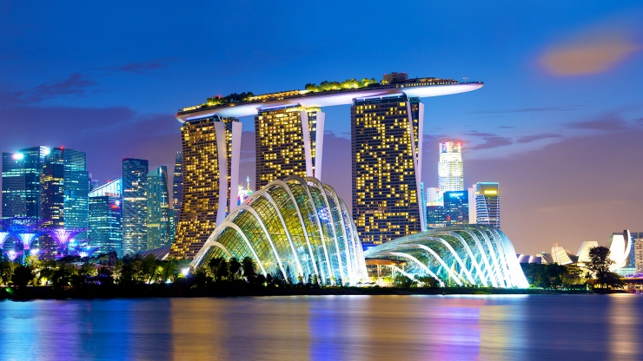
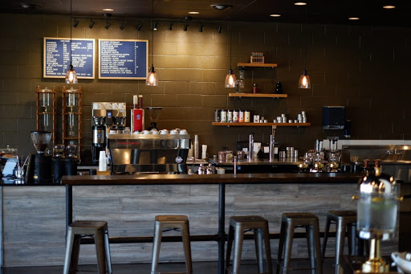
Capstone Project:The Battle of Neighborhoods (week2)
To Find out Location of New Coffee Shop near Marina Bay Sands Hotel

Slide 2
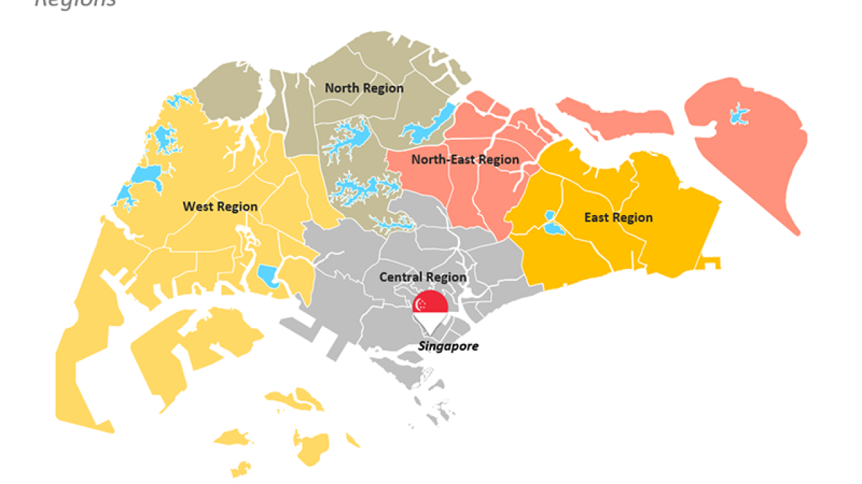
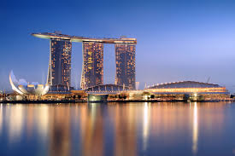
Capstone Project:The Battle of Neighborhoods (week2)
Introduction :
The Marina Bay Sands Hotel is located at Marina Bay in Singapore. The Marina Bay Sands Hotel is the most beautiful Hotel in Singapore. There are many tourists to stay here every years. So I think I should open Coffee shop near this hotel.

Slide 3
Capstone Project:The Battle of Neighborhoods (week2)
Business Problem :
1. Find existing coffee shops around the Marina Bay Sands Hotel in radius 1.0 Km..
2. Find rating of exiting coffee shops for consideration to open new Coffee shop

Slide 4
Capstone Project:The Battle of Neighborhoods (week2)
Data Sources :
From www. Foursquare.com
Marina Bay Sands Hotel :
Address : 10 Bayfont Ave, 018986, Singapore
Location :
Latitude : 1.283695
Longtitude : 103.8607722
List of 30 coffee Shops near Marina Bay Sands Hotel
Location of 30 Coffee shops (blue points) around Marina Bay Sands Hotel ( red point)

Slide 5
Capstone Project:The Battle of Neighborhoods (week2)
5 Coffee Shops near Marina Bay Sands Hotel with Tip Rating
Coffee Shop Name | Distance from Marina Bay Sands Hotel (m) | Rating
1. The Coffee Bean & Tea Leaf Beanstro | 220 | 5.4
2. Trung Nguyen Coffee | 343 | 6.4
3. Hill Street Coffee Shop | 450 | 5.3
4. Robert’s Coffee | 647 | -
5. The Coffee Bean & Tea Leaf | 880 | 6.3
The highest rating is Trung Nguyen Coffee

Slide 6
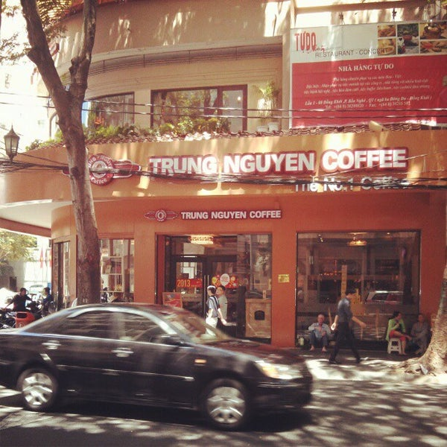
Capstone Project:The Battle of Neighborhoods (week2)
Reviewed Trung Nguyen Coffee by Mr.Richard
Reviewer :Mr.Richard

Slide 7
Capstone Project:The Battle of Neighborhoods (week2)
Discuss Section :
I think I should select location of my new coffee shop near Marina Bay Sands hotel less than 500. m. but it should be located opposite Trung Nguyen coffee shop.
Conclusion section :
The survey data from www.Foursquare.com do not enough for make final decision to open Coffee shop. It need to find out data from other websites.

